Slide 1
8086 Microprocessor

Slide 2
16 bit processor
The 8086 is a 16-bit microprocessor intended to be used as the CPU in a microcomputer.
The term “16-bit” means that its arithmetic logic unit, internal registers, and most of its instructions are designed to work 16-bit binary words.
It has 16-bit data bus and 20-bit address bus

Slide 3
Features
8086 is a 40 pin IC.
It is a 16-bit processor.
Its operating voltage is 5 volts.
Its operating frequency is 5 MHz •
The total memory addressing capacity is 1MB (external).
It has 16-bit data bus and 20-bit address bus.
It has fourteen 16-bit registers. •
It has around 20000 transistors in its circuitry, and it is made in HMOS (High-speed Metal Oxide Semiconductor) technology.
Pipelining improves the performance of the processor so that operation is faster.
8086 uses two stage of pipelining.
First is Fetch Stage and the second is Execute Stage.
Fetch stage that prefetch upto 6 bytes of instructions stores them in the queue.
Execute stage then executes these instructions

Slide 4
Features
8086 uses memory banks:The 8086 uses a memory banking system. It means entire data is not stored sequentially in a single memory of 1 MB but memory is divided into two banks of 512KB.
Interrupts:8086 has 256 vectored interrupts.
Multiplication and Division:8086 has a powerful instruction set. So that it supports Multiply and Divide operation.

Slide 5
PIN diagram - 8086
The 8086 signals can be categorized into three groups.
The first are the signals having common functions in minimum as well as maximum mode
The second are the signals which have special functions in minimum mode
The third are the signals having special functions for maximum mode

Slide 6
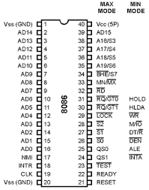

Slide 7
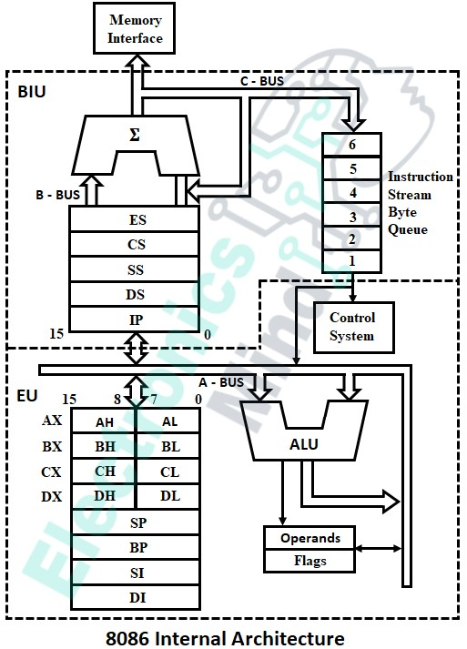
Block Diagram - 8086
BIU
EU

Slide 8
Functional parts of 8086
The Bus Interface Unit
The BIU handles all data and addresses on the buses for the execution unit such as it sends out addresses, fetches instructions from memory, reads data from ports and memory as well as writes data to ports and memory. In BIU there are so many functional groups or parts these are as follows.
Instruction Queue
Segment Registers
Instruction Pointer (IP)

Slide 9
To increase the execution speed, BIU fetches as many as six instruction bytes ahead to time from memory.
The prefetched instruction bytes are held for the EU in a first in first out group of registers called an instruction queue.

Slide 10
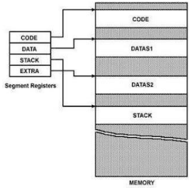
Four 16-bit segment registers
1.Code Segment (CS): The CS register addresses a memory location in the Code Segment of the memory, where the executable program is stored.
2. Data Segment (DS): The DS contains most data used by program. Data are accessed in the Data Segment by an offset address or the content of other register that holds the offset address.
3. Stack Segment (SS): SS defined a section of memory to store addresses and data while a subprogram executes.
4. Extra Segment (ES): ES is additional data segment that is used by some of the string to hold the extra destination data

Slide 11
Instruction Pointer (IP)
The instruction pointer (IP) holds the 16-bit address of the next code byte within this code segment

Slide 12
Functional parts of 8086
The Execution Unit
The execution unit (EU) tells the BIU where to fetch instructions or data from, decodes instructions, and executes instructions.
The functional parts of the execution unit are control circuitry or system, instruction decoder, and Arithmetic logic unit (ALU).
Control circuitry to perform various internal operations.
A decoder in the EU translates instructions fetched from memory to generate different internal or external control signals that required performing the operation.
The EU has a 16-bit ALU, which can perform arithmetic operations such as add, subtract etc. and logical operations such as AND, OR, XOR, increment, decrement, etc.

Slide 13
Flag Registers
A 16-bit flag register is a flip-flop which indicates some condition produced by the execution of an instruction or controls certain operations of the EU.
Carry Flag (CF): This flag will be set to one if the arithmetic operation produces the carry in MSB position. It is also used in multiple-precision arithmetic.
Auxiliary Flag (AF): If an operation performed in ALU generates a carry/barrow from lower nibble (i.e. D0 – D3) to upper nibble (i.e. D4 – D7), the AF flag is set i.e. carry given by D3 bit to D4 is AF flag. This is not a general-purpose flag; it is used internally by the processor to perform Binary to BCD conversion.
Parity Flag (PF): This flag is used to indicate the parity of result. If lower order 8-bits of the result contains even number of 1’s, the Parity Flag is set to one and for odd number of 1’s, the Parity Flag is reset i.e. zero. •
Zero Flag (ZF): It is set to one; if the result of arithmetic or logical operation is zero else it is reset.
Sign Flag (SF): In sign magnitude format the sign of number is indicated by MSB bit. If the result of operation is negative, sign flag is set to one
Overflow Flag (OF): It occurs when signed numbers are added or subtracted. An OF indicates that the result has exceeded the capacity of machine

Slide 14
General purpose registers
The EU has eight general purpose registers labeled AH, AL, BH, BL, CH, CL, DH, and DL.
These registers can be used individually for temporary storage of 8-bit data.
The AL register is also called the accumulator.
Certain pairs of these general-purpose registers can be used together to store 16-bit data.
The valid register pairs are AH and AL, BH and BL, CH and CL and DH and DL.

Slide 15
These register pairs are referred to as AX, BX, CX, and DX respectively.
AX Register: For 16-bit operations, AX is called the accumulator register that stores operands for arithmetic operations.
BX Register: This register is mainly used as a base register. It holds the starting base location of a memory region within a data segment.
CX Register: It is defined as a counter. It is primarily used in loop instruction to store loop counter.
DX Register: DX register is used to contain I/O port address for I/O instruction

Slide 16
Stack Pointer Register
The stack pointer (SP) register contains the 16-bit offset from the start of the segment to the memory location where a word was most recently stored on the stack. The memory location where a word was most recently stored is called the top of stack.
Other Pointer and Index Registers
The EU also contains a 16-bit source index (SI) register, base pointer (BP) registers, and Destination Index (DI) registers. These three registers can be mainly used for temporary storage of 16-bit data just like a general-purpose register

Slide 17
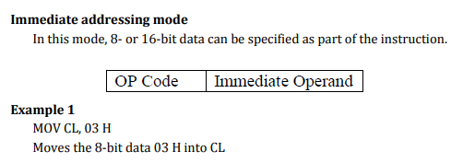
Addressing Modes of 8086

Slide 18
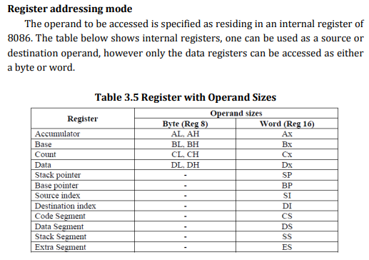
Example 1
MOV DX , CX
Which moves 16-bit content of CS into DX.
Example 2
MOV CL, DL
Moves 8-bit contents of DL into CL MOV BX, CH is an illegal instruction.

Slide 19
Direct addressing mode
The instruction Opcode is followed by an effective address
This effective address is directly used as the 16-bit offset of the storage location of the operand from the location specified by the current value in the selected segment register

Slide 20

The 20-bit physical address of the operand in memory is normally obtained as PA = DS: EA
But by using a segment override prefix (SOP) in the instruction, any of the four segment registers can be referenced
The EU cannot directly access the memory operands.
It must use the BIU, to access memory operands.
In the direct addressing mode, the 16-bit effective address (EA) is taken directly from the displacement field of the instruction.
The effective address is formed by adding an 8-bit or 16-bit displacement with the sum of contents of anyone of the base registers (BX or BP) and any one of the index registers (SI or DI), in a default segment.

Slide 21
MOV CX, START
If the 16-bit value assigned to the offset START by the programmer using an assembler pseudo instruction such as DW is 0040 and [DS] = 3050.
Then BIU generates the 20-bit physical address 30540 H.
The content of 30540 is moved to CL
The content of 30541 is moved to CH

Slide 22
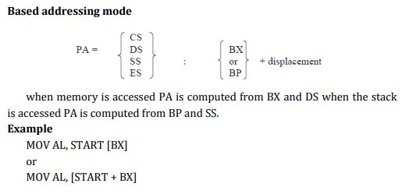
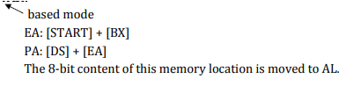

Slide 23
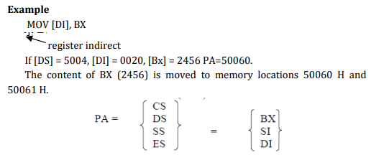
Register indirect addressing mode
The EA is specified in either pointer (BX) register or an index (SI or DI) register.
The 20-bit physical address is computed using DS and EA.

Slide 24
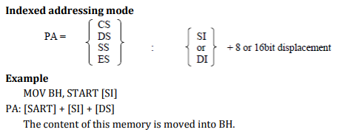

Slide 25
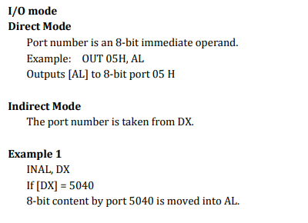

Slide 26
